Slide 1
Military

Slide 2
Minister of Defense (MoD)
At the start of your turn:
You may move any number of your troops to a tile adjacent to them that you own or has a “casus belli” token on it
Intelligence Check:
When doing an intelligence check against a nation, roll a die
Add the <intelligence> to the result
If desired:
Roll upto <# of extra optional dice> additional dice.
Add or subtract <Dice modifier> from each dice
If the result is 5 or greater, the intelligence check is successful
At the end of your turn:
Commence all battles
Battle:
If there are two opposing sides in a tile, a battle occurs in that tile
Commence battle, Risk style
If you are participating in the battle and win it, gain 1 Hard Power Token
# of draws: 2
Non-Basic Hand Size Limit: 3
Nuke and Uranium Pool
1
2
3
4
5
6
7
8
9
10
11
12
13
14
15
16
17
18
19
20
21
22
23
24
1
2
3
4
5
6
7
8
9
10
11
12
13
14
15
16
17
18
19
20
21
22
23
24
Worker Pool

Slide 3
Foreign Affairs

Slide 4
Minister of Foreign Affairs (MoFA)
Whenever you succeed in playing an international agreement:
Gain 1 “soft power” token
Diplomacy Check:
When doing an diplomacy check against a nation, roll 1 die
Add the <diplomacy> to the result
If desired:
Roll upto <# of extra optional dice> additional dice.
Add or subtract <Dice modifier> from each dice
Spend X “soft power” tokens to increase score by X
If the result is 5 or greater, the intelligence check is successful
# of draws: 1 Non-Basic Hand Size Limit: 2
1
2
3
4
5
6
7
8
9
10
11
12
13
14
15
16
17
18
19
20
21
22
23
24
Soft Power Pool
1
2
3
4
5
6
7
8
9
10
11
12
13
14
15
16
17
18
19
20
21
22
23
24
Worker Pool

Slide 5
Science

Slide 6
Minister of Research (MoR)
Research:
If you play a “Research” card, you attempt to research it by reaching the “Research Number” indicated on the top right side of the card by doing the following:
roll 1 die
If desired:
Roll upto <# of extra optional dice> additional dice.
Add or subtract <Dice modifier> from each dice
Use BEDMAS on the dice results as well as the “Research Number” on the previously done researches
If the above does not reach to the exact number, you may commit X workers and X coins to add/subtract X from the result
If the “Research Number” is reached, then the research is a success. Activate the effects written on the card
# of draws: 3 Non-Basic Hand Size Limit: 4
1
2
3
4
5
6
7
8
9
10
11
12
13
14
15
16
17
18
19
20
21
22
23
24
Worker Pool

Slide 7
Commerce

Slide 8
Minister of Commerce (MoC)
YOLO!
# of draws: 2 Non-Basic Hand Size Limit: 3
1
2
3
4
5
6
7
8
9
10
11
12
13
14
15
16
17
18
19
20
21
22
23
24
Gold
1
2
3
4
5
6
7
8
9
10
11
12
13
14
15
16
17
18
19
20
21
22
23
24
Worker Pool

Slide 9
Labor

Slide 10
Minister of Labor (MoL)
YOLO!
# of draws: 0 Non-Basic Hand Size Limit: 0
1
2
3
4
5
6
7
8
9
10
11
12
13
14
15
16
17
18
19
20
21
22
23
24
Gold
1
2
3
4
5
6
7
8
9
10
11
12
13
14
15
16
17
18
19
20
21
22
23
24
Worker Pool

Slide 11
Event

Slide 12
Foreign Nation

Slide 13

Hexagon Stability &
Influence
Ownership
cover

Slide 14
-2: If your nation’s happiness is higher, get a worker from this nation at the start of their turn
-1:
0
1
2: If your nation’s happiness is lower, give 1 worker to this nation at the start of this nation’s turn
Happiness
-2: Lose the Game if this nation has at least one nuke. Otherwise, enter war with this nation
-1: Cancel all international agreements with this nation
0
1
2: International agreements can be made with this nation
Diplomacy
-2: If your relations are less than 1 with this nation, each player draws 1 fewer card whenever they draw
-1:
0
1: This nation’s deck’s top card is always revealed
2: Whenever this nation plays a card, you may reduce intelligence by 1 and negate the effect
Intelligence
1
2
3
4
5
6
7
8
9
10
11
12
13
14
15
16
17
18
19
20
21
22
23
24
Military
1
2
3
4
5
6
7
8
9
10
11
12
13
14
15
16
17
18
19
20
21
22
23
24
Workforce
1
2
3
4
5
6
7
8
9
10
11
12
13
14
15
16
17
18
19
20
21
22
23
24
Tradable Goods
0: Other nations can declare war on this nation
1
2
3
4
Nukes

Slide 15
-2
-1
0
1
2
Happiness
1
2
3
4
5
6
7
8
9
10
11
12
13
14
15
16
17
18
19
20
21
22
23
24
Soft Power
1
2
3
4
5
6
7
8
9
10
11
12
13
14
15
16
17
18
19
20
21
22
23
24
Hard Power
1
2
3
4
5
6
7
8
9
10
11
12
13
14
15
16
17
18
19
20
21
22
23
24
Military
1
2
3
4
5
6
7
8
9
10
11
12
13
14
15
16
17
18
19
20
21
22
23
24
Workforce
1
2
3
4
5
6
7
8
9
10
11
12
13
14
15
16
17
18
19
20
21
22
23
24
Tradable Goods
0: Other nations can declare war on this nation
1
2
3
4
Nukes

Slide 16
# of extra optional dice
0
Card Cost Reduction
# of times a player’s played card can be activated
0
Gold from unused population
Dice modifier
0
# of Cards Playable
0
1
2
3
4
5
6
7
8
9
10
11
12
13
14
15
16
17
18
19
20
21
22
23
# of Alien Races
Star Wars

Slide 17
Common Actions & Turn Structure
At the start of a phase:
Draw the # of cards indicated in your player sheet
If there are no cards to draw, shuffle all cards from your discard pile into your draw pile
Play up to <# of Cards Playable> cards by placing them face down in front of you
Play order goes from the entity with the “first player token”, going clockwise
Voting:
When voting, each player may choose to commit any number of their uncommitted workers to an option
The option with the majority # of committed workers on it wins
At the end of a phase:
Pass the “first player” token to your left
Activate any “end of phase” effects
If you have more non-basic cards than in your <Non-Basic Hand Size Limit>, discard non-basic cards down to that limit
At the start of your turn:
Activate any “at the start of your turn” effects
During your turn:
Activate the cards you have put face down in the order you choose
Any “Basic Action” cards goes back to your hand after it is resolved. Any other card goes to your discard pile
At the end of your turn:
Activate any “at the end of your turn” effects
Gain 1 gold for each worker you have in your worker pool that has not been committed.
Uncommit all committed workers

Slide 18
Foreign Nation Actions
Activate any “at the start of turn” effects
Draw a card from the nation’s deck and resolve it’s effect
Troop movement:
If they are at war with a nation, or neutral territory, move the troops of this nation using the following logic
Stay in an area if there are enemy soldiers there
If enemies are in adjacent tiles, move to the tile that has the least amount of enemies. Only do this if this movement will result in there being equal or higher number of this nation’s soldiers in the tile compared to the enemy of this nation
Go towards an area that has the highest number of friendly units
If they are not at war, move the troops in a way that distributes them equally between their territories

Slide 19
Kardashev Scale
0.
7
8
1
2
3
4
5
6
7
8
9
1
2
3
4
5
6
7
8
9
9
(?) KS effects
1
2
3
4
5
6
7
8
9

Slide 20



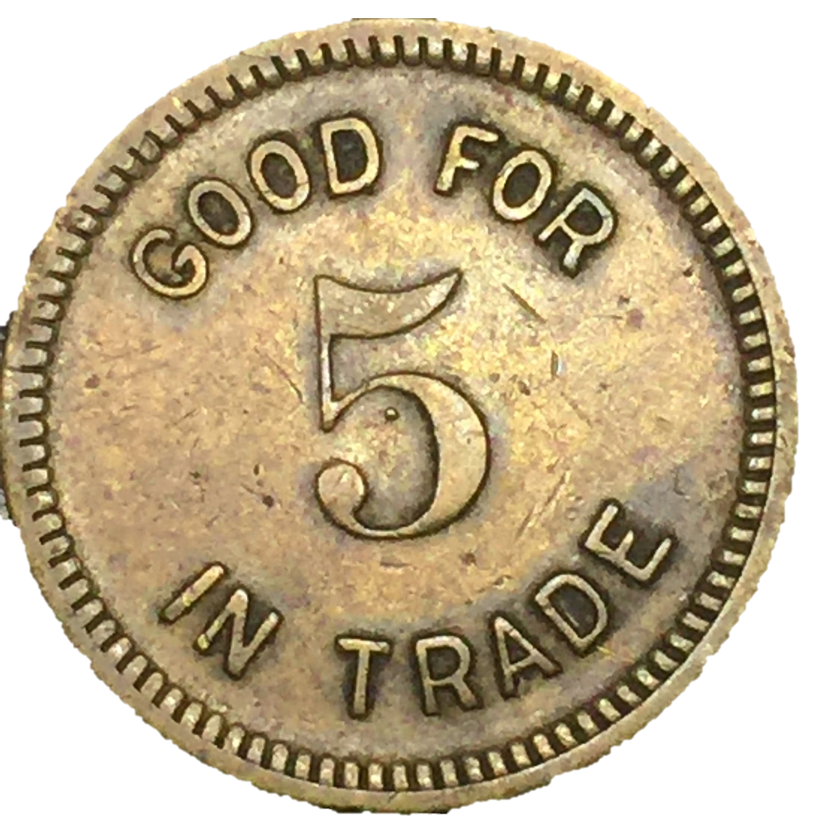


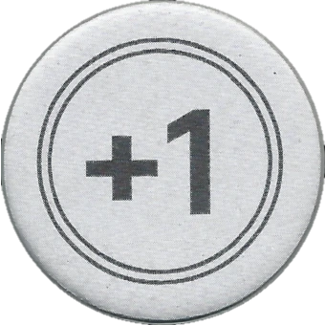



Tokens

